Slide 1
Parent Forum
Attendance and Communication

Slide 2
Attendance

Slide 3
The government expects:
Schools and local authorities to:
Promote good attendance and reduce absence, including persistent absence;
ensure every pupil has access to full-time education to which they are entitled;
and,
act early to address patterns of absence.
Parents to perform their legal duty by ensuring their children of compulsory school age who are registered at school attend regularly.
All pupils to be punctual to their lessons.

Slide 4
Regular
IOW vs Platt
Full time education – 100% of the time
School rules
Sensible prosecution 31 vs 30
Law – to ensure your child receives efficient full-time education suitable to their age, ability, aptitude, either by regular attendance at school or otherwise.

Slide 5
School Attendance and the Law
There is no longer any entitlement in law for pupils to take time off during the term to go on holiday. In addition, the Supreme Court has ruled that the definition of regular school attendance is “in accordance with the rules prescribed by the school”.
The Education (Pupil Registration) (England) Regulations 2006 were amended in September 2013. All references to family holidays and extended leave have been removed. The amendments specify that headteachers may not grant any leave of absence during term time unless there are "exceptional circumstances" and they no longer have the discretion to authorise up to ten days of absence each academic year.

Slide 6
Promoting Regular Attendance
Helping to create a pattern of regular attendance is the responsibility of parents, pupils and all members of school staff.
To help us all to focus on this we will:
Give parents/carers details on attendance in our newsletters
Report to parents/carers annually on their child’s attendance with the annual school report.
Contact parents/carers should their child’s attendance fall below the school’s target for attendance.
Celebrate excellent attendance by displaying and reporting individual and class achievements
Reward good or improving attendance

Slide 7
Authorised absences
Authorised absences are mornings and/or afternoons away from school for
a good reason like illness (although you may be asked to provide
medical evidence for your child before this can be authorised), medical
or dental appointments which unavoidably fall in school time,
emergencies or other unavoidable cause.

Slide 8
Unauthorised absences
Unauthorised absences are those which the school does not consider reasonable and for which no ‘leave’ has been given. This type of absence can lead to the Local Authority using sanctions and/or legal proceedings.
Unauthorised absence includes:
parents/carers keeping children off school unnecessarily e.g. because they had a late night or for non-infectious illness or injury that would not affect their ability to learn.
absences which have never been properly explained
children who arrive at school too late to get a mark on the attendance register
shopping trips
looking after other children or children accompanying siblings or parents to medical appointments
their own or family birthdays
holidays taken during term time without leave- 5 days unauthorised absence will lead to a penalty notice being triggered by the Local Authority
day trips
other leave of absence in term time which has not been agreed

Slide 9
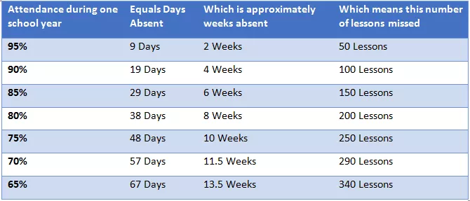
Discussion
Attendance Awards – Termly / Weekly
96% +
Weekly class awards
Parent suggestions sent in –
Sickness – Do more …
48 hours
Honesty
Local schools Oct
Six week holidays

Slide 10
Communication

Slide 13
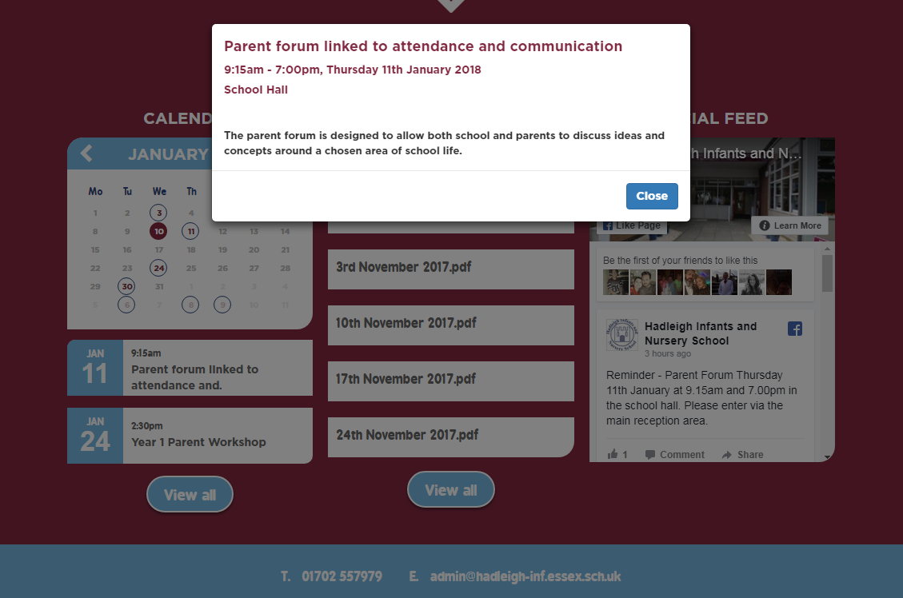

Slide 16
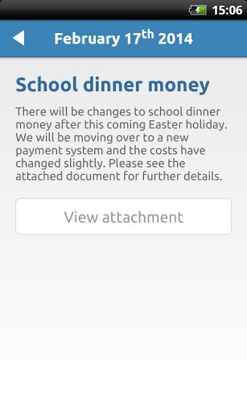

Slide 17
Discussion
Better / worse
What is the easiest way to share information
Too soon / Too late
Ideas to improve communication
Parent suggestions sent in –
Small slips with information
All letters to be uploaded not just NL
Further explanation on NL of dates

