Slide 1

Phonics

Slide 2
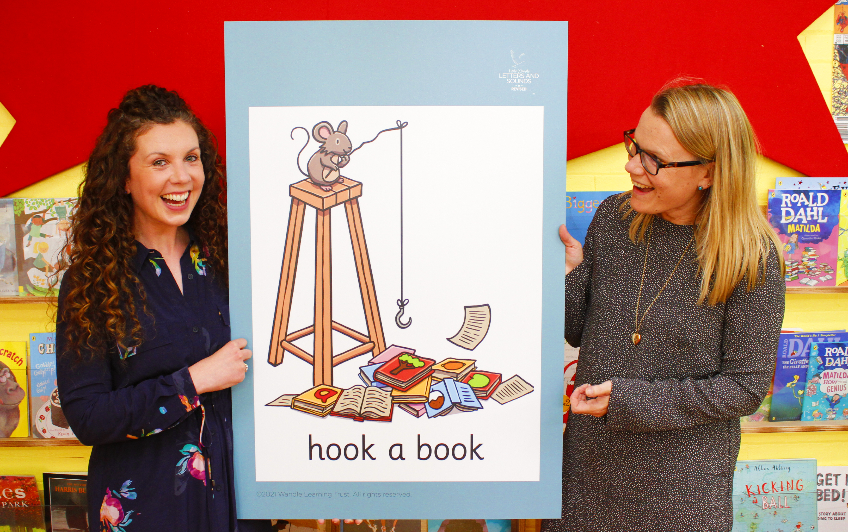
Little Wandle Letters and Sounds Revised
Our school has chosen
Little Wandle Letters and Sounds Revised as our systematic, synthetic phonics (SSP) programme to teach early reading and spelling.

Slide 3
Phonics is:
making connections between the sounds of our spoken words and the letters that are used to write them down.
Notes:
It sounds complicated but it really isn’t!

Slide 4
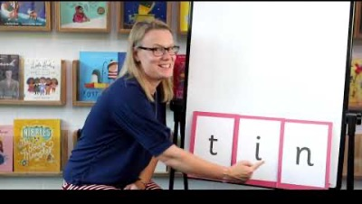
Blending to read words
Notes:
Some children learn to blend really quickly, and others take a little longer. If your child is finding it difficult, ask your child’s teacher for ways to help at home – playing blending games at home is so helpful!
Show parents this video from the website: https://www.littlewandlelettersandsounds.org.uk/resources/for-parents/

Slide 5
Terminology
Phoneme
Split vowel digraph
Grapheme
Blend
Digraph
Segment
Trigraph
Notes:
Explain what each word means – use our glossary to help: https://www.littlewandlelettersandsounds.org.uk/resources/my-letters-and-sounds/getting-started/

Slide 6
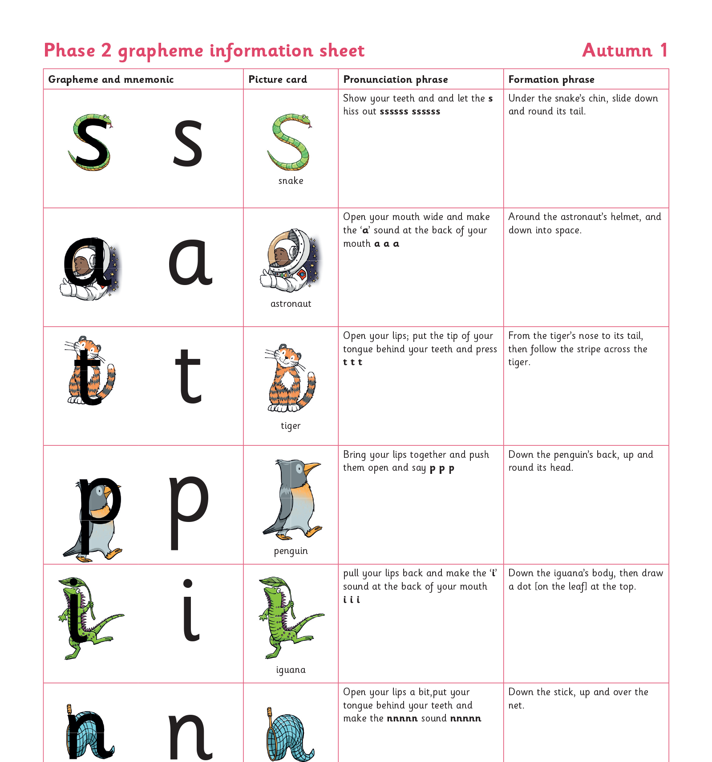
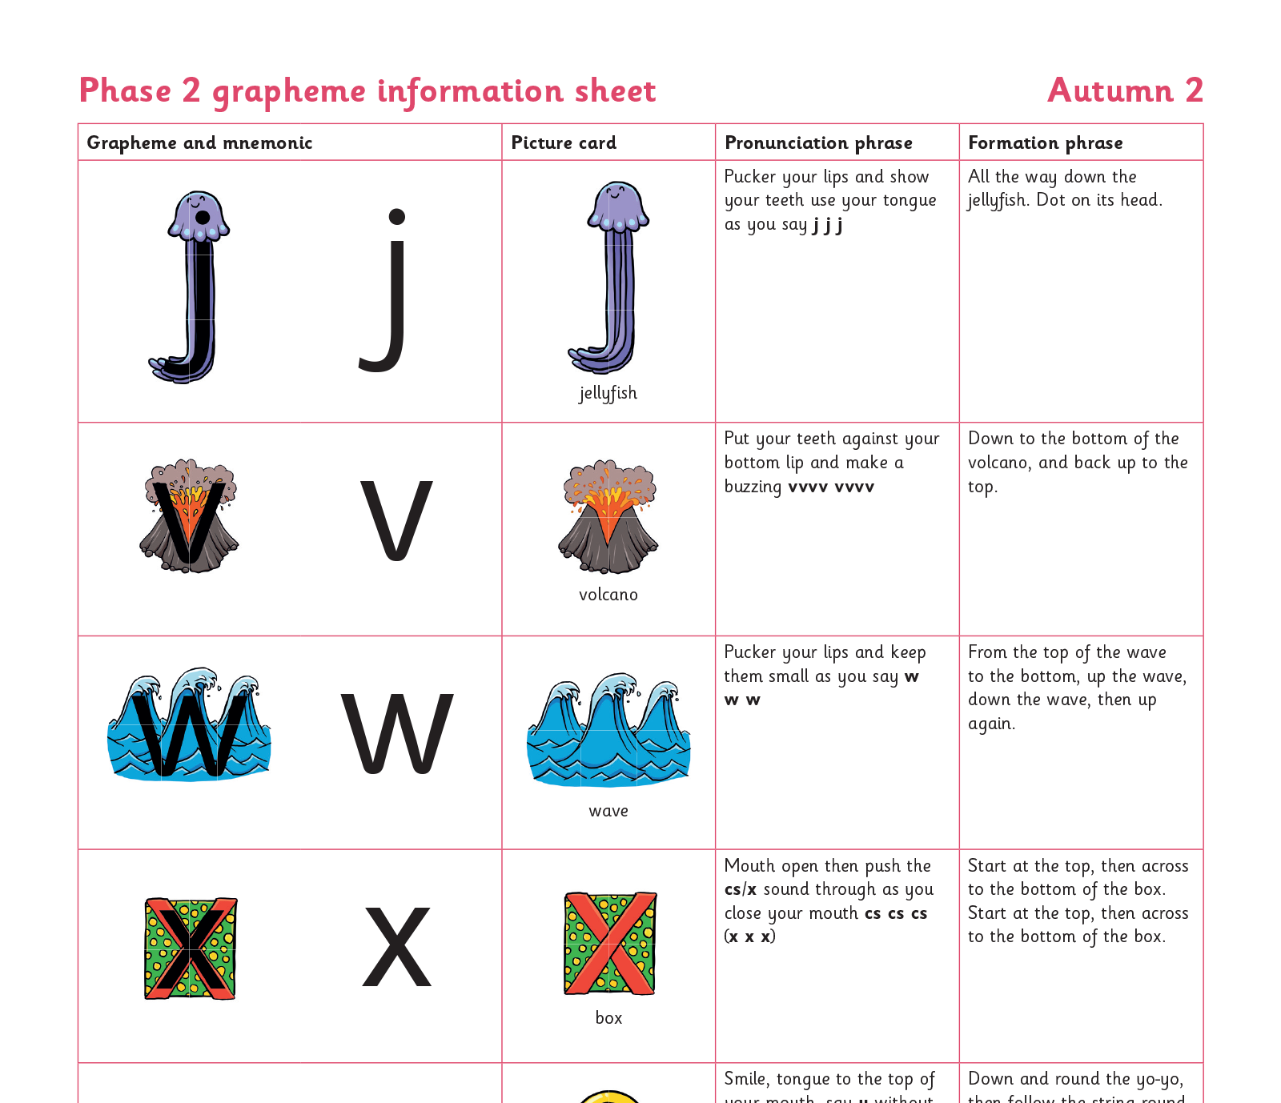
Teaching order
Notes:
We usually teach four new sounds a week and have a review lesson on a Friday. You will get a list of the sounds that we are learning to have at home. This will help you with formation and pronunciation.

Slide 7
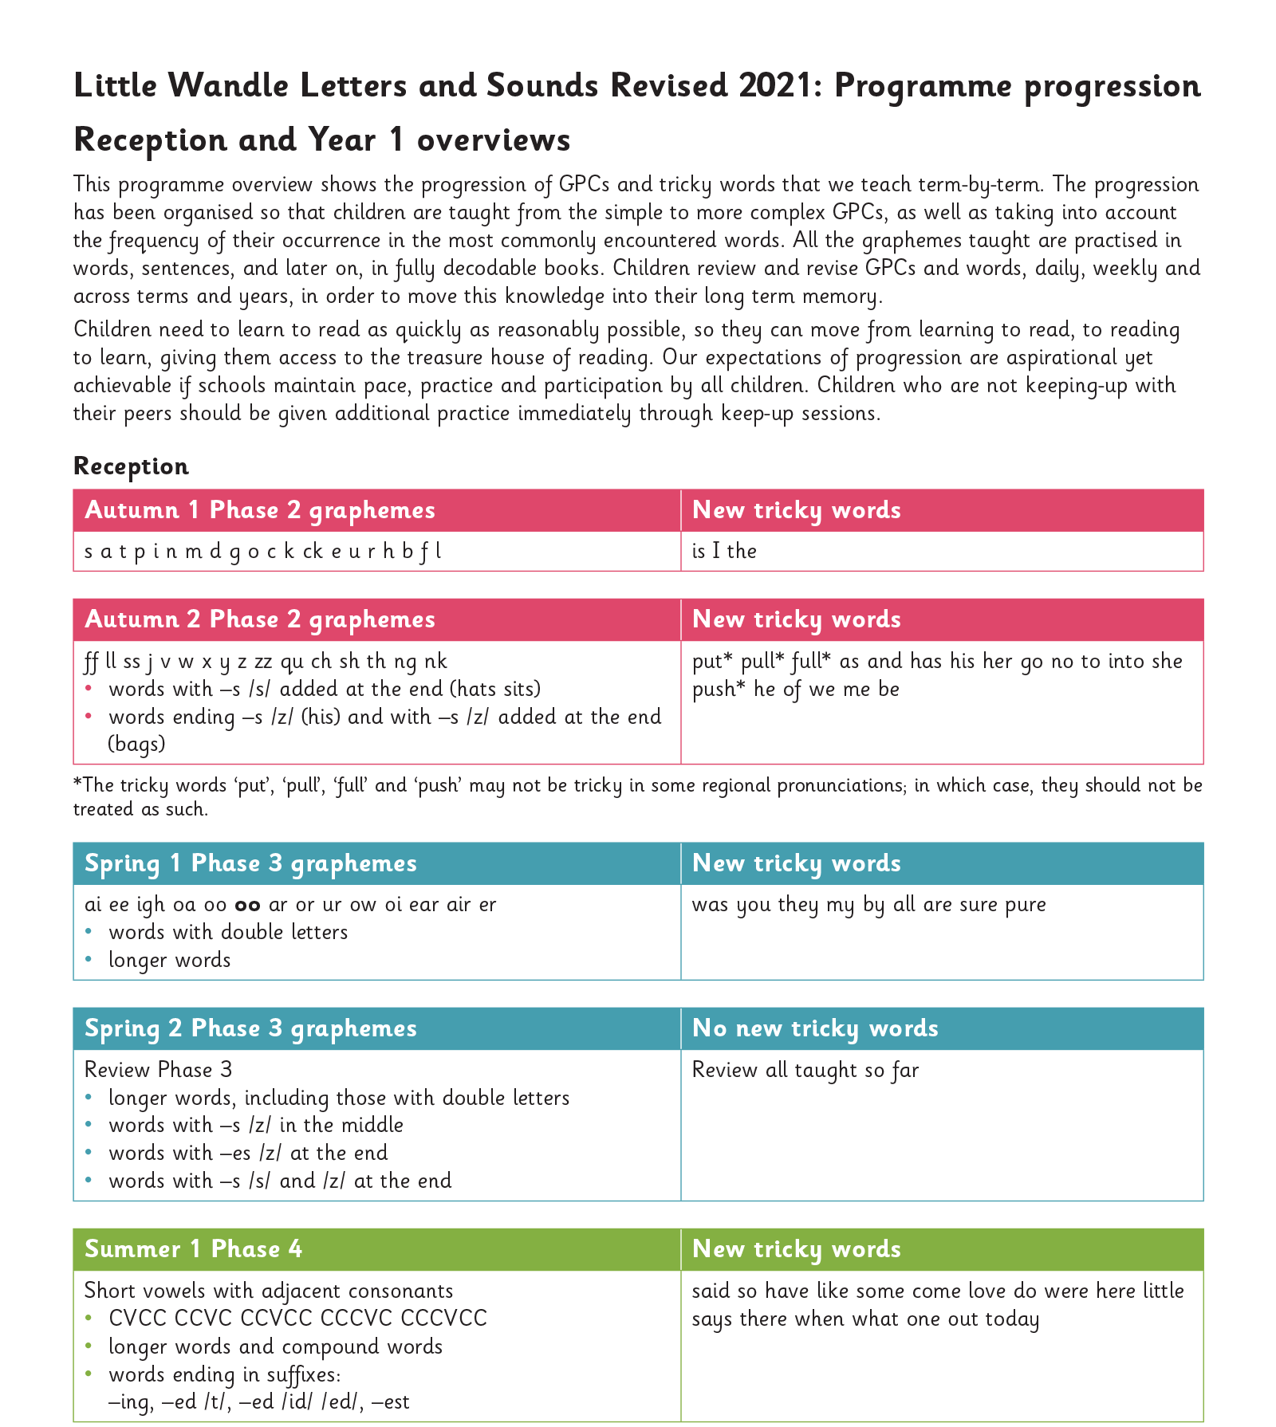
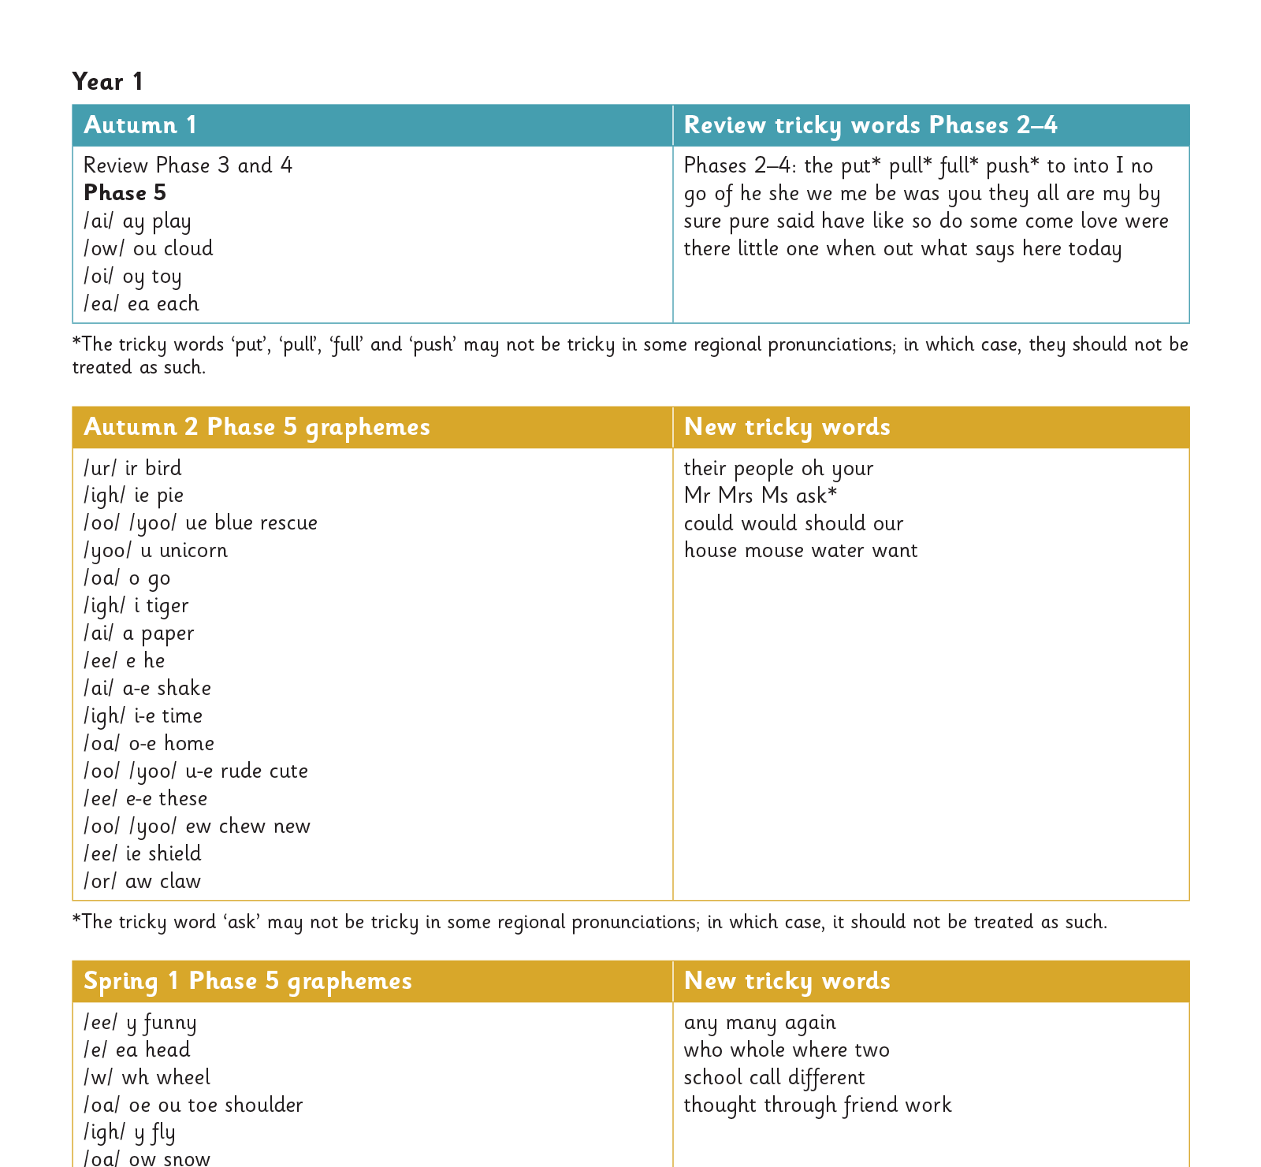
Gradually your child learns the entire alphabetic code:
Notes:
We will work our way through the whole Little Wandle Programme until your child can read fluently.

Slide 8
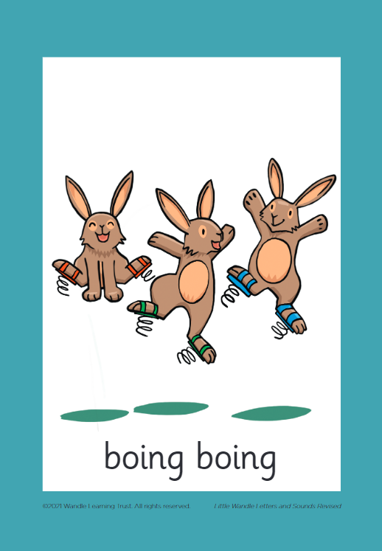



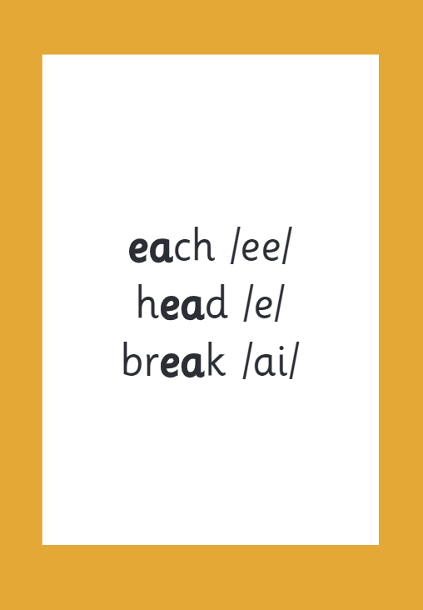

How we make learning stick
Notes:
There are specific resources for the Little Wandle Programme which the children will be very familiar with. Each sound that we teach to begin with has either a mnemonic (like the astronaut that you can see here) or a phrase like boing-boing for ‘oi’. This helps the children recognise and remember the graphemes. Every time we teach a new sound, we also read words during the phonics lesson that contain that new sound so that the children practise what they have learned. We then go on to reading a sentence containing some of those words. We have displays in the classroom and on the tables to support the children throughout the day.

Slide 9
Reading and spelling

Slide 10
Reading and spelling
Notes:
This is an example of what the children learn in Year 1.
Children learn that there are graphemes that can have different sounds and sounds that can be made with different letters.
Use the backs and fronts of Phase 5 cards to show ‘ea’ and ‘ow’.

Slide 11
And all the different ways to write the phoneme sh:
shell
chef
special
caption
mansion
passion

Slide 12
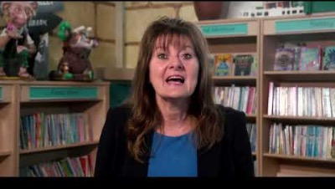
Tricky words
Notes:
Have a look at this video on the website: https://www.littlewandlelettersandsounds.org.uk/resources/for-parents/

Slide 13

Spelling
Say the word.
Segment the sounds.
Count the sounds.
Write them down.
Notes:
Model the process on a flipchart for the parents to see.

Slide 14
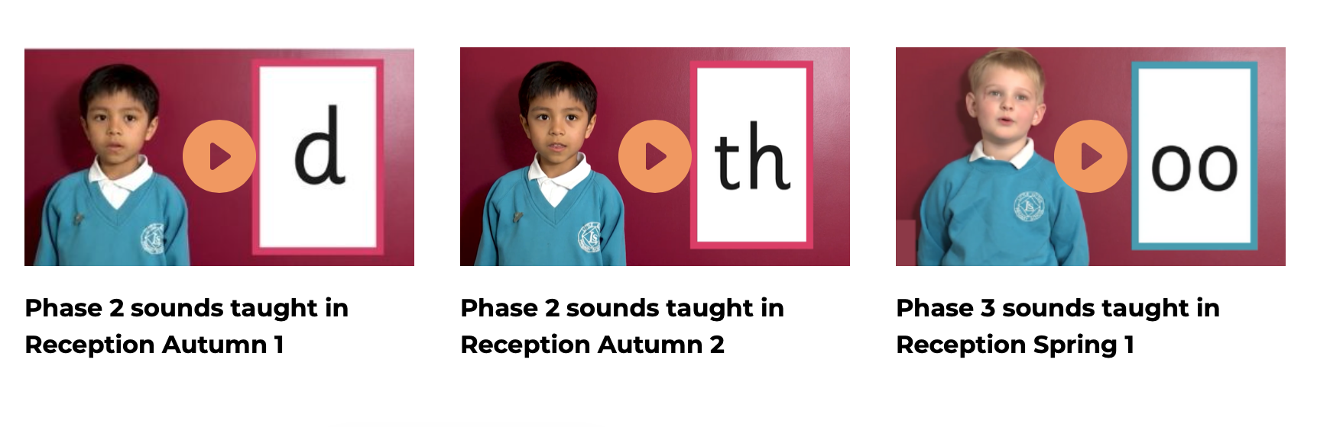
Supporting your child with phonics
Notes:
It is really important that you pronounce the sounds correctly at home if you are supporting your child. These videos are on the website for you to refer to and if you are unsure, please ask your child’s teacher.
Show the parents where to access the videos on the website and play them!
https://www.littlewandlelettersandsounds.org.uk/resources/for-parents/

Slide 15
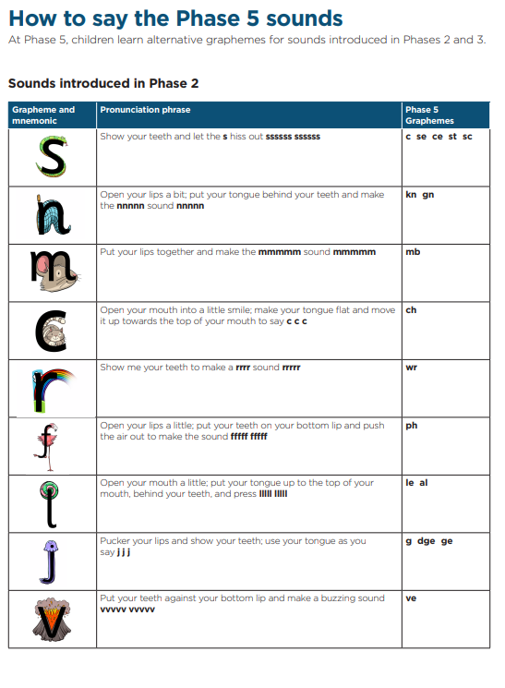
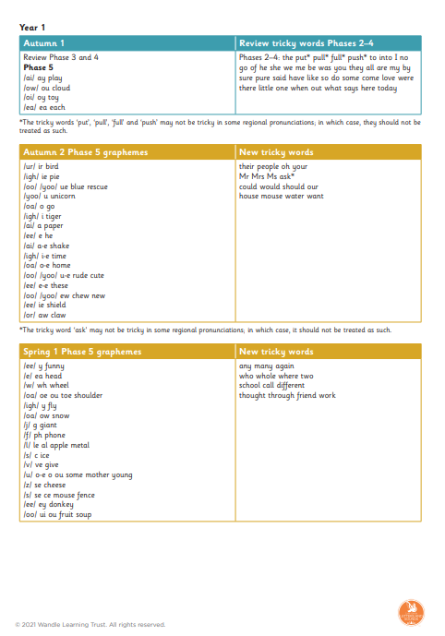
Resources we will be sending home:

