Slide 1
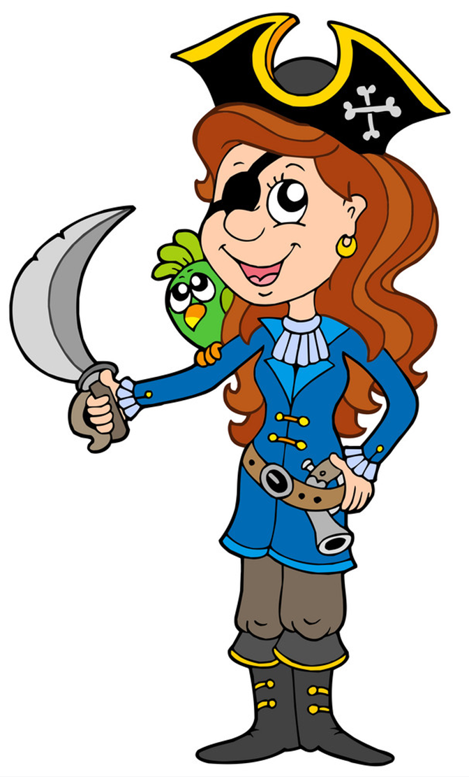
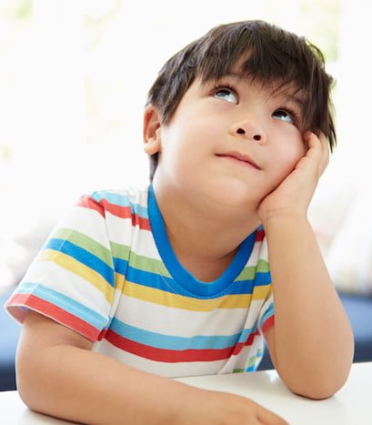
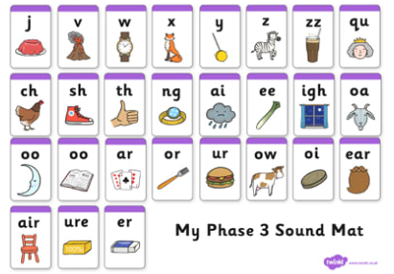
Pirate writing.
Firstly have a look at a pirate picture. You could use one of the pictures on the next page or find one of your own.
Think of as many words as you can to describe the pirate.
Then say your sentence. You could start with …
The pirate is … He has …. She can ….
See if you can make your sentence longer using
and or because
Use your sound mat to help you.
Don’t forget your finger spaces between words.
Start with a capital letter and finish with a full stop.

Slide 2
